Slide 1

Разбор домашнего задания №4 Тренировки по ML
Arkadii Lysiakov

Slide 2



Outline
01
Reminder of models
02
Feature selection
03
Baseline review

Slide 3
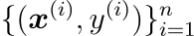
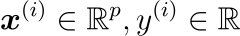
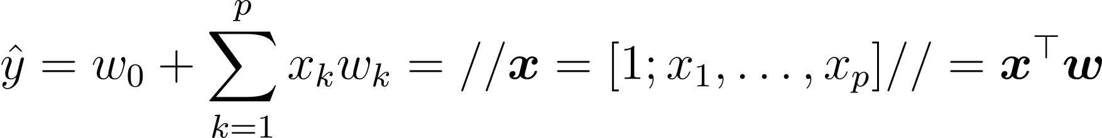
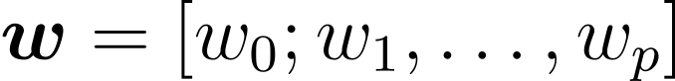
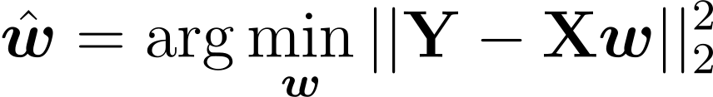
Linear regression
Linear regression problem statement:
01
Dataset
, where
02
The model is linear:
, where
is bias term
03
Least squares method (MSE minimization) provides a solution:

Slide 4

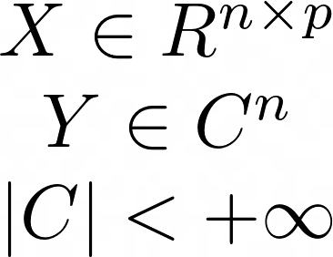
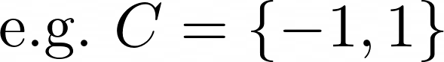

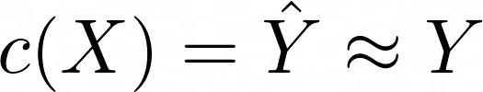
Logistic regression

Slide 5
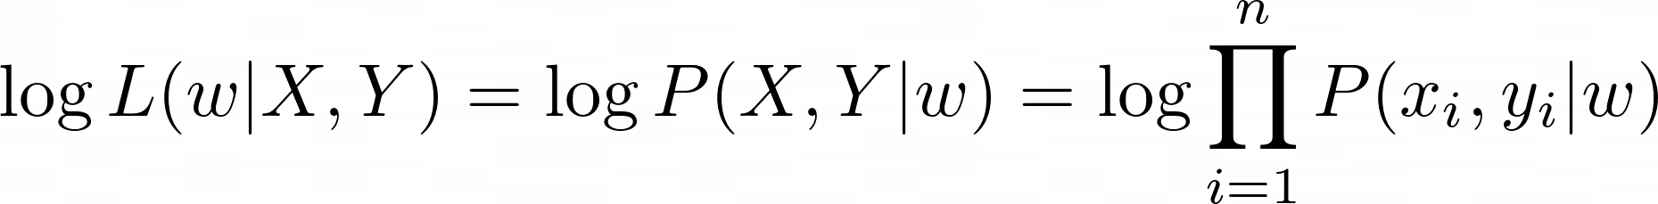
Logistic regression
Just to remind
Calculating probabilities for objects
Notes:
MAE(\mathbf{y}, \mathbf{\hat{y}}) = \|\mathbf{y} - \mathbf{\hat{y}}\|_1 = \sum_i |y_i - \hat{y}_i|

Slide 6
Boosting: intuition
Binary classification
Use decision stumps

Slide 7
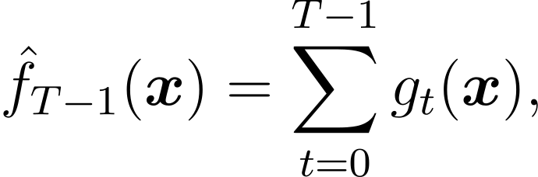
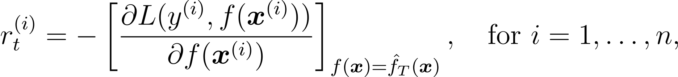
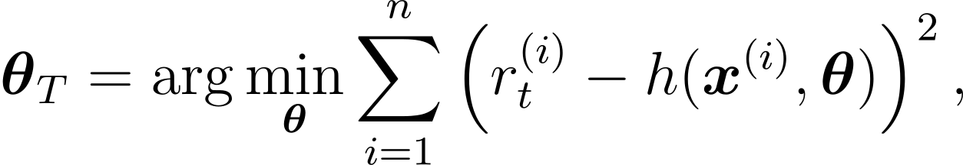
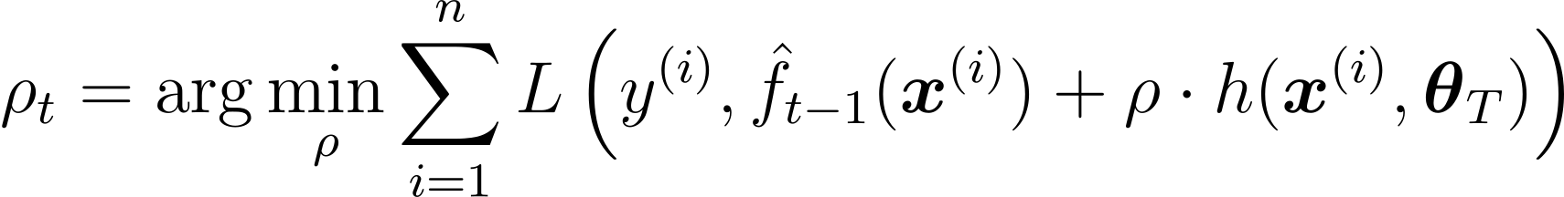
Gradient boosting
01
02
03
04

Slide 8
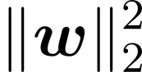

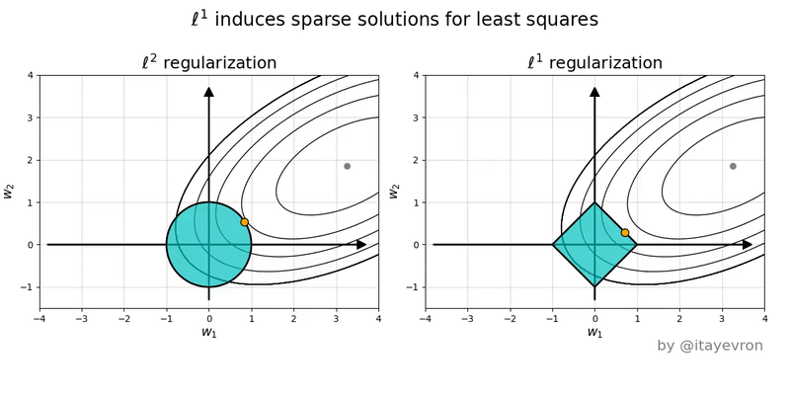
Regularization
L2 regularization
L1 regularization
source: https://people.eecs.berkeley.edu/~jrs/189/

Slide 9
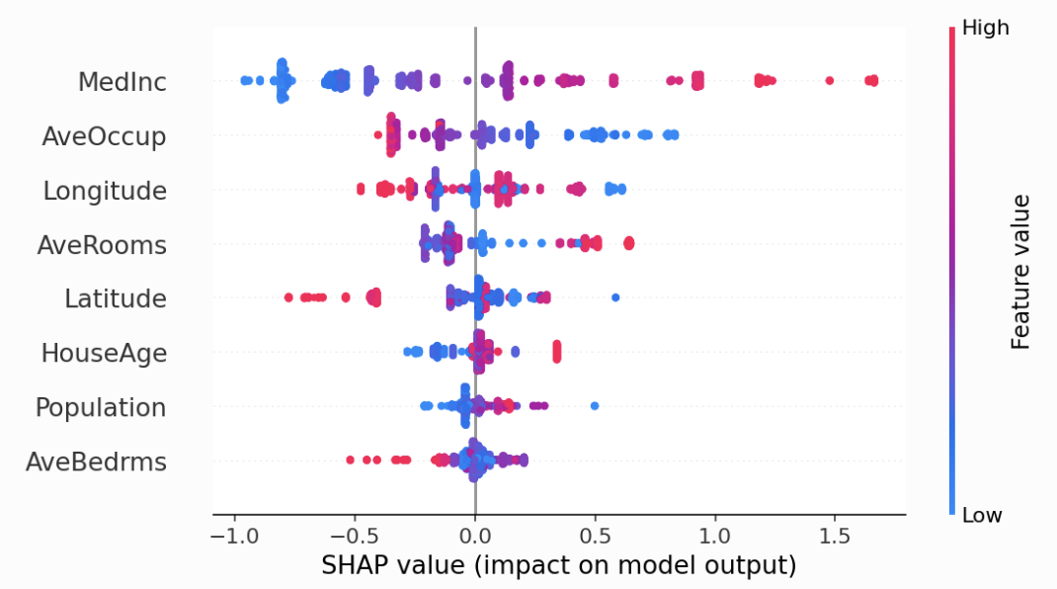
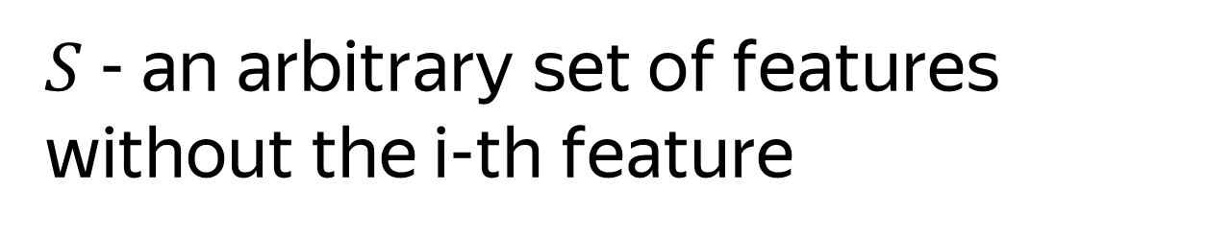

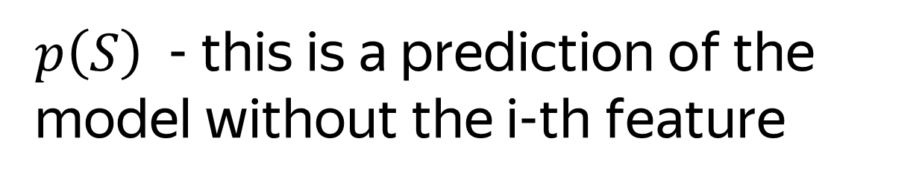
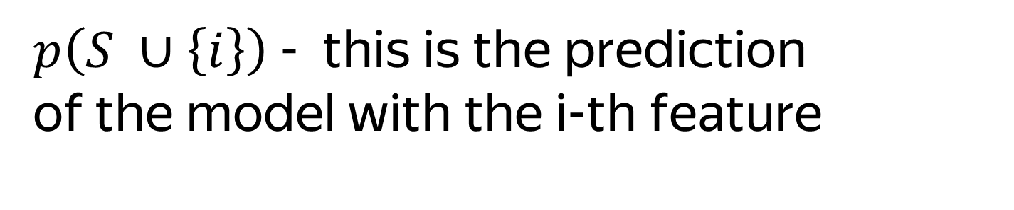
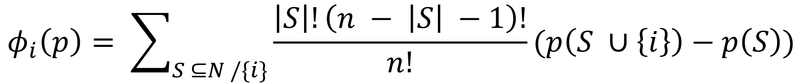
Shap values
$$φ_{i}\left(p\right)= \sum_{S ⊆N /\{i\}}{\frac{\left|S\right|!\left(n − \left|S\right| −1\right)!}{n!}}(p\left(S ∪\left\{i\right\}\right)−p\left(S\right))$$
$p\left(S ∪\left\{i\right\}\right)$ - this is the prediction of the model with the i-th feature
$p\left(S\right)$ - this is a prediction of the model without the i-th feature
$n$ - number of features
$S$- an arbitrary set of features without the i-th feature
source: https://shap.readthedocs.io/en/latest/example_notebooks/overviews/

Slide 10
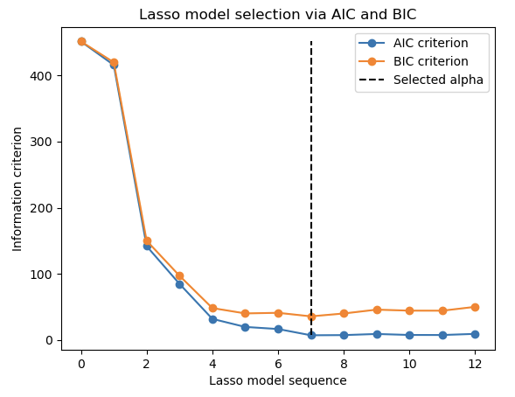


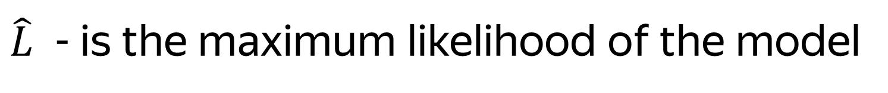
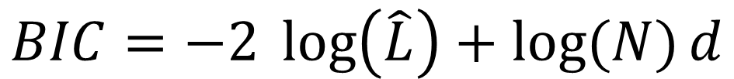
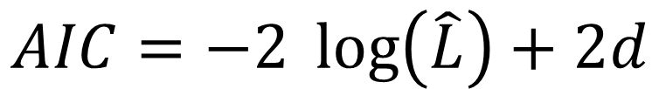
Information-criteria based model selection
$$AIC=−2 \log\left(\hat{L}\right)+2d$$
$$BIC=−2 \log\left(\hat{L}\right)+\log{(N)}d$$
$\hat{L}$ - is the maximum likelihood of the model
$d$- is the number of parameters
$N$- is the number of samples
source: https://scikit-learn.org/dev/modules/linear_model.html

Slide 11
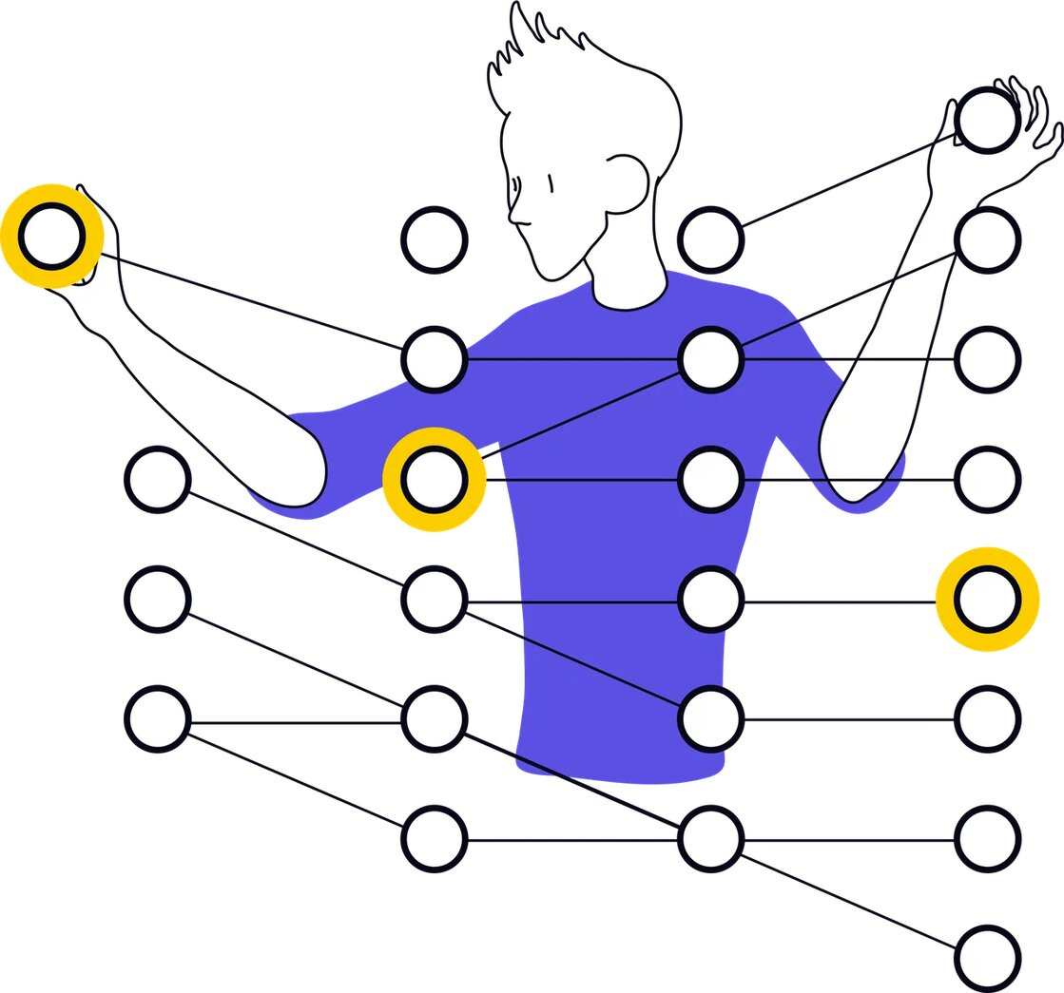
Lifecode

Slide 12

Thanks for attention!
Questions?

